Slide 1
Excel internship 2017
By Tim Senanayake and Hannah Short
Supervisors: Mike Wald and Yunjia Li

Slide 2
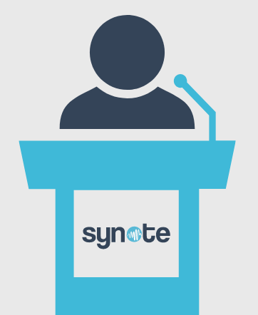
Introduction to Synote
Synote is a collaborative editing tool for students
When a lecture is recorded, Synote transcribes the audio
Slides are shown in correspondence with the audio
Students can access and correct the transcript if necessary
Source: synote.com

Slide 3
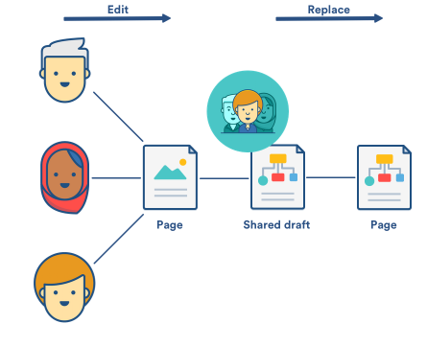
Problem definition
Editing transcripts in real time
How to get the best edit possible
Calculated using a scoring system, or statistically?
Do we assume users check every word or make them confirm?
Some users’ edits given priority based on user reputation
Paying an excessive fee to store users and their login details
Source: https://developer.atlassian.com/confdev/collaborative-editing-for-confluence-server

Slide 4


Tools used
Amazon Web Services
DynamoDB
Cognito
Lambda
API Gateway
Elastic Beanstalk
REST clients
Chrome Advanced REST Client
Postman
Node.js command line
Github and Slack
Source: aws.amazon.com
Source: https://www.migenius.com/articles/exploring-the-realityserver-json-rpc-api

Slide 5
What did we achieve?
Implementing a Node.js Express app
Enabling multiple configurations on the app
Adding token authentication
Unit and integration testing
Deploying the current stages of the app
Writing thorough documentation

Slide 6
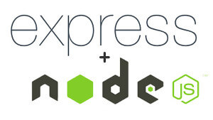
Implementing a Node.js Express app
Worked in conjunction with Cognito user pools and DynamoDB tables
Focussed on back-end
Used Express – a flexible web app framework
Source:
www.erwan-datin.com

Slide 7
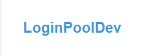
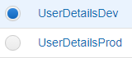

Enabling multiple configurations on the app
We separated development and production data stores in AWS
Our app accommodates for specific environments with JSON config files
Environment can be set prior to running the app
Source: Our AWS DynamoDB tables (left) and Cognito user pools (right)

Slide 8
Adding token authentication
We used tokens to ensure only logged in users could access certain pages – tested using Postman
Access tokens used to access a web page – expires after a short time period
Refresh tokens used to obtain a new access token once the previous one has expired – expires after a longer time period
We used Passport, an authentication middleware which can be easily implemented in Express-based applications

Slide 9

Unit and integration testing
We used Mocha and Chai as testing frameworks
We currently have a few basic tests running
Given more time we would have been able to test more thoroughly
Throughout the process, we performed regression tests
Source:
kuroeveryday.blogspot.com

Slide 10
Deploying the current stages of the app
We used Docker alongside AWS Elastic Beanstalk to deploy our app
Initially, we created an image of the app using Docker
We were then able to deploy this image on Elastic Beanstalk
The app can be accessed via the environment URL
By adding /<route-name> to the address the entirety of the application can be accessed i.e. http://expessapp-env.6b9hmwghi9.us-east-2.elasticbeanstalk.com/createusers

Slide 11
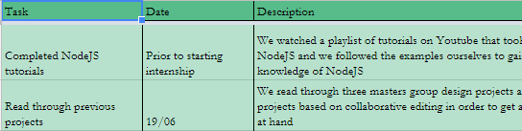
Writing thorough documentation
We wrote a brief log of the tasks we had completed for future reference
We supplied an exhaustive ReadME file with all the steps we took to build our app in our Github repository
We tried to commit as regularly as possible to keep a clearer record of the modifications being made to the code
Source:
Google
Sheets

Slide 12
What have we gained?
We have learnt a new programming language
We have gained experience with Amazon Web Services
We have gained experience in web development
We have learnt of the importance of thorough documentation
We have experienced working in a professional environment

Slide 13
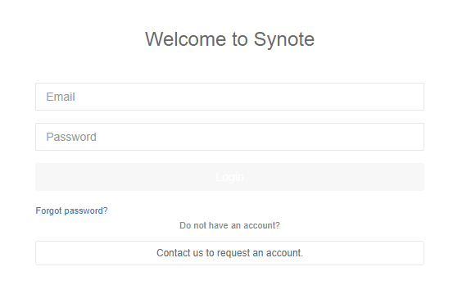
Future work
Front end of the login system – receiving user input as opposed to using test data
More extensive testing to ensure all aspects of the application work as intended
(Address problems with real-time editing and how to obtain the best edit for the transcript)
Source: synote.com’s current login screen

Slide 14

Thank you for listening

